Slide 1
Classification and clustering of bank data using Hadoop, Pig and R
GUIDED BY,
Dr.S.BALAKRISHNAN,
Department of Information Technology,
SKCET.
PROJECT SUBMITTED BY,
AGILAN S 15EUIT003
ARUNKUMAR A K 15EUIT011
FAHEEN FATHIMA B N 15EUIT030
VINITHA B 16EUIT518

Slide 2
OBJECTIVES
To classify the customers based on their previous transactions(not only on current salary and assets)
To categorize them into low, medium and high risk customers.
To decide if the holder can be approved of the credit card and loans
To enables banks to do marketing by understanding their customers.
To enable the banks to identify the target customers.

Slide 3
EXISTING SYSTEM
“According to RBI statistics, a bank can handle 8,00,00,000 transactions in a single month”
KAGGLE COMPETITIONS:
“An important part of succeeding as an insurance company is having a good understanding of which of the company’s current customers will be with the company into the future. The goal of this competition is to predict which current customers will still be with the company in 6 months, given many of the customer’s characteristics.”
“Using an anonymized database of information on customer and sales activity, including property and coverage information, Homesite is challenging you to predict which customers will purchase a given quote. Accurately predicting conversion would help Homesite better understand the impact of proposed pricing changes and maintain an ideal portfolio of customer segments.”

Slide 4
PROBLEM STATEMENT
Based on the current salary, assets owned by the customers may not help to classify the customers accurately.
Customers with valuable assets and good salary may show reluctance to payback loans
Customers with not much valuable assets and an average salary may pay the loans properly
Hence understanding the behaviour / nature customers become tedious for the banks.

Slide 5
PROPOSED SYSTEM
Using Hadoop ecosystem to perform analysis over the bank customer data
Classifying customers into High, Medium and Low risk customers.
Clustering and analysing the clusters.
Classification using Hadoop framework and Apache Pig
Clustering and analysis using R Programming

Slide 6
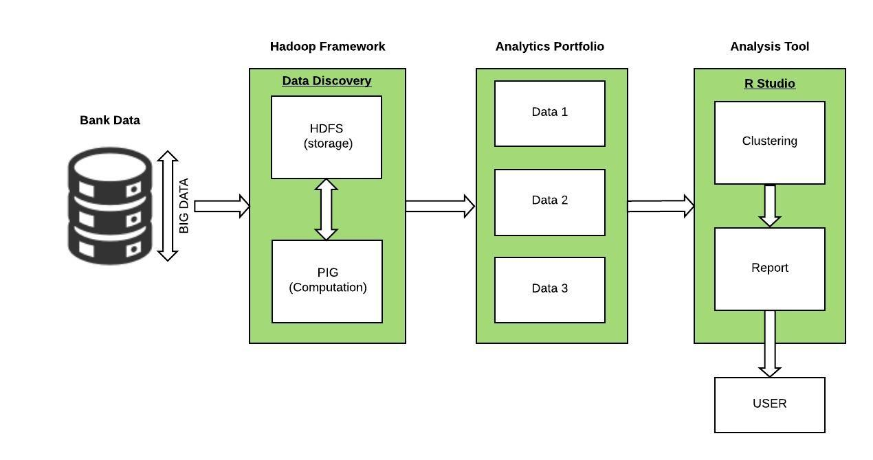
SYSTEM ARCHITECTURE

Slide 7
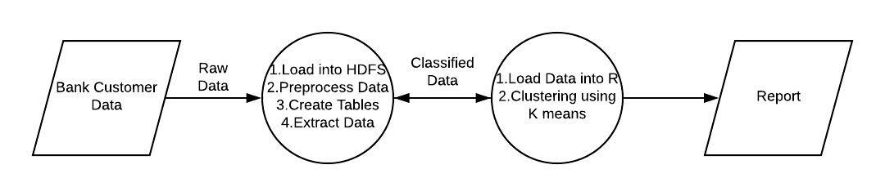
CONTEXT DIAGRAM

Slide 8
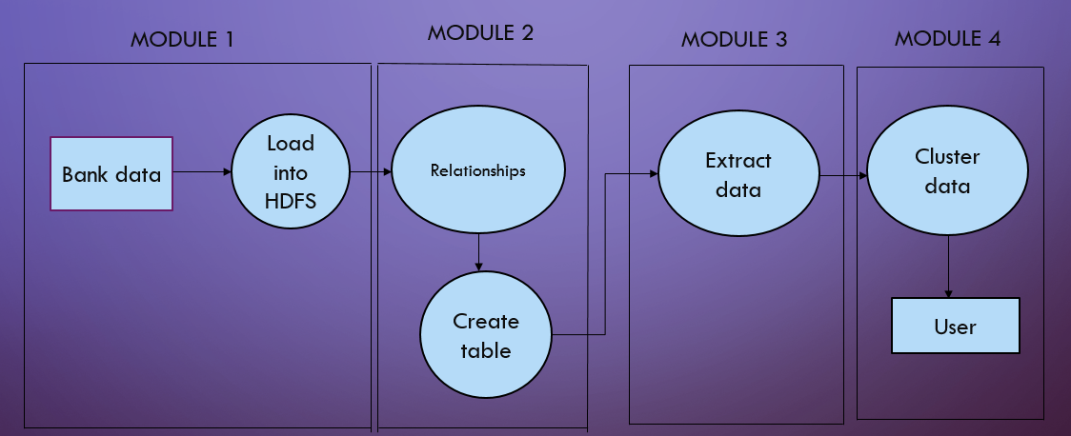
DATA FLOW DIAGRAM

Slide 9
MODULES
Preprocessing Data
Creating relationships and tables
Classification of data
Clustering data

Slide 10
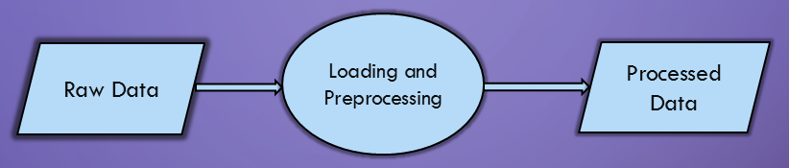
Preprocessing data Module 1
INPUT – Dataset in Ascii format
OUTPUT – Data in an .csv format
PROCESS -
Load data into HDFS
Use Apache pig commands to clean data

Slide 11
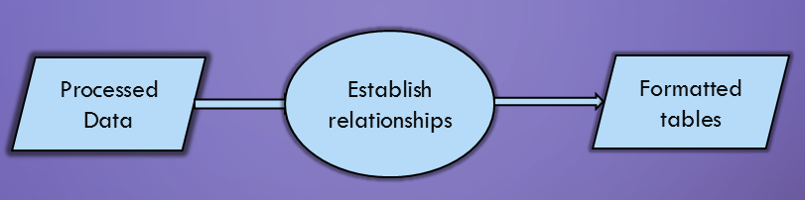
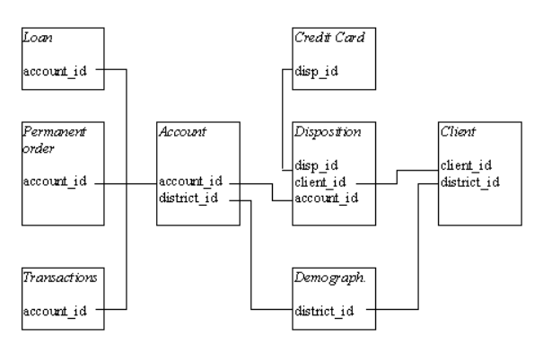
Establishing relationships and creating tables Module 2
INPUT - .csv files
OUTPUT - Tables
PROCESS - Pig Latin queries on creating relationships and tables

Slide 12
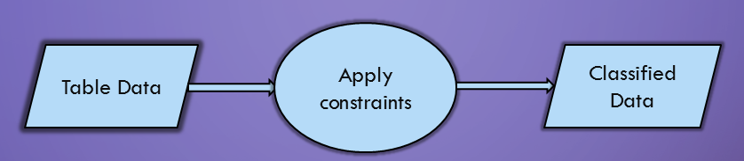
Extracting data Module 3
METHOD
INPUT - Formatted tables
OUTPUT - Three datasets containing high, medium and low risk customers
PROCESS –
Establish query statements using Latin
Classify data into three sets namely high, low and medium risk customers.
Store it into the HDFS
Parameters considered
Transaction amount
Loan status
Credit card status
Average salary
Age
Unemployment rate
Entrepreneurship rate
Disposition

Slide 13
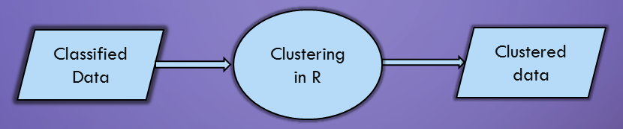

Clustering data Module 4
K-Means clustering-Formula
METHOD
INPUT - Classified data
OUTPUT - Clustered data
PROCESS –
Load data into R Studio
Cluster using K-means Algorithm
Plot graphs for interface
||x_{i} - v_{j}|| is Eucledian Distance
Ci is number of datapoints in ‘i’ cluster
C cluster centers

Slide 14
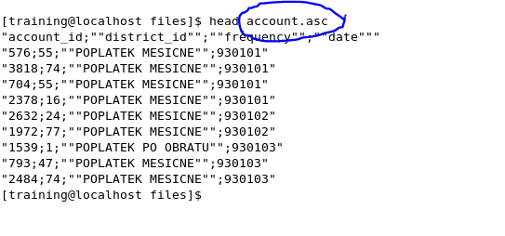
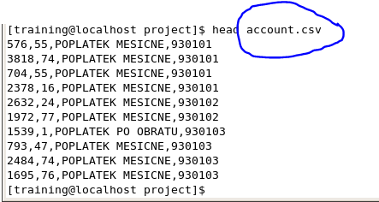
MODULE-1 PREPROCESSING DATA

Slide 15
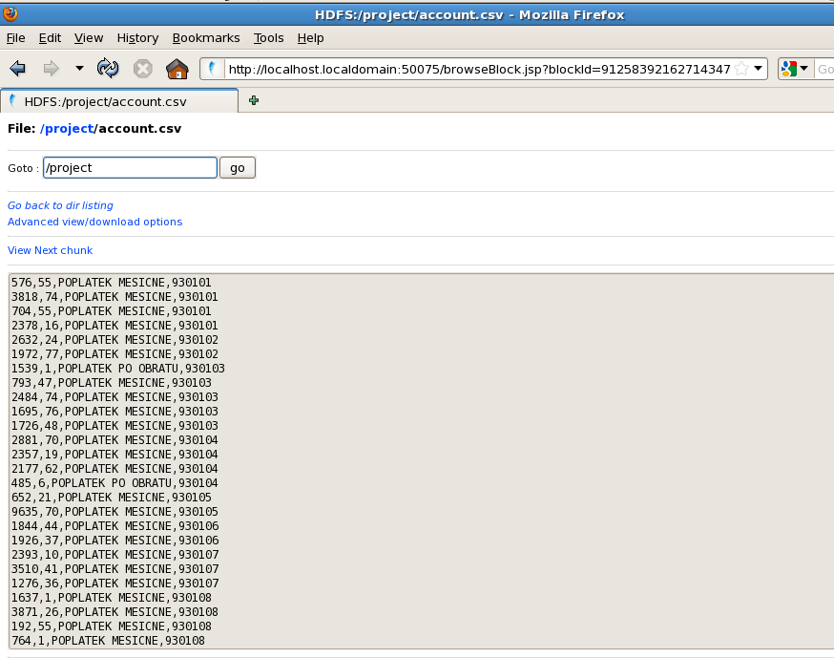
LOADING DATA INTO HDFS

Slide 16
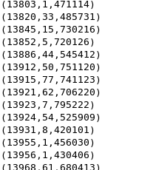
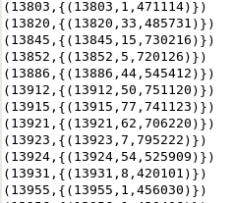
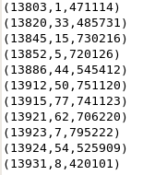
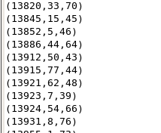
MODULE 2 PROCESSING OF DATA
CLIENT-FIELDS = CLIENT ID, BIRTHNUMBER,DISTRICT ID
INSERTING FIELDS
FORMING TUPLES
FLATTENING TUPLES
FINDING AND INSERTING AGE

Slide 17
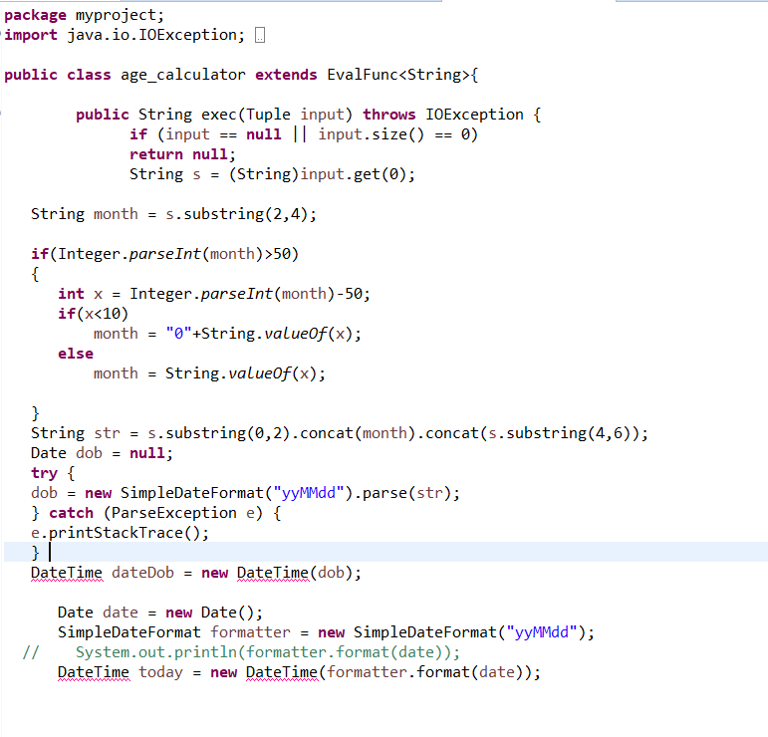
USING OF JAR FILES

Slide 18
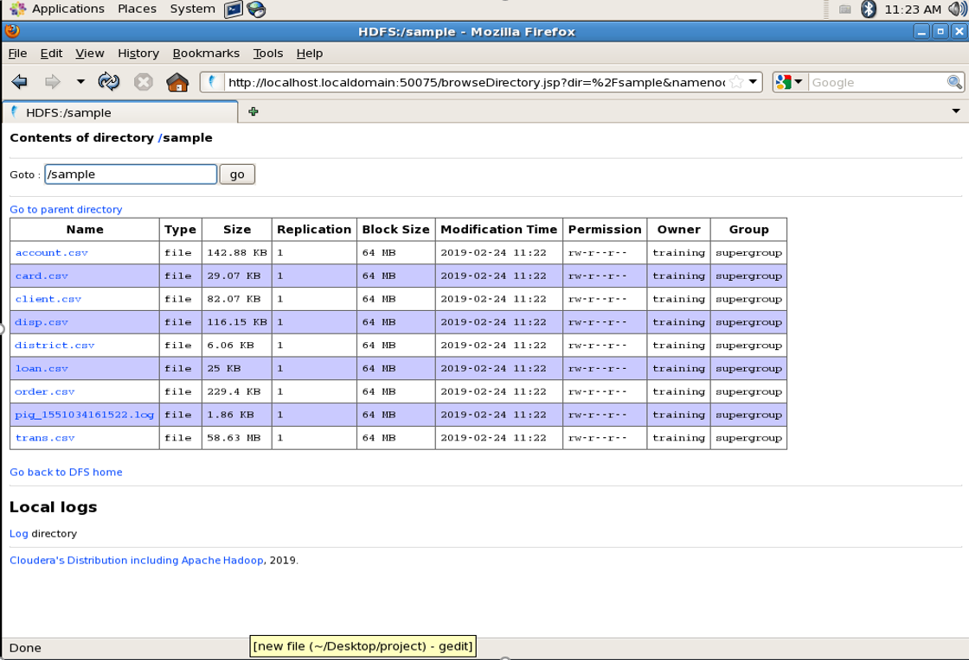
MODULE 3 EXTRACTING DATA

Slide 19
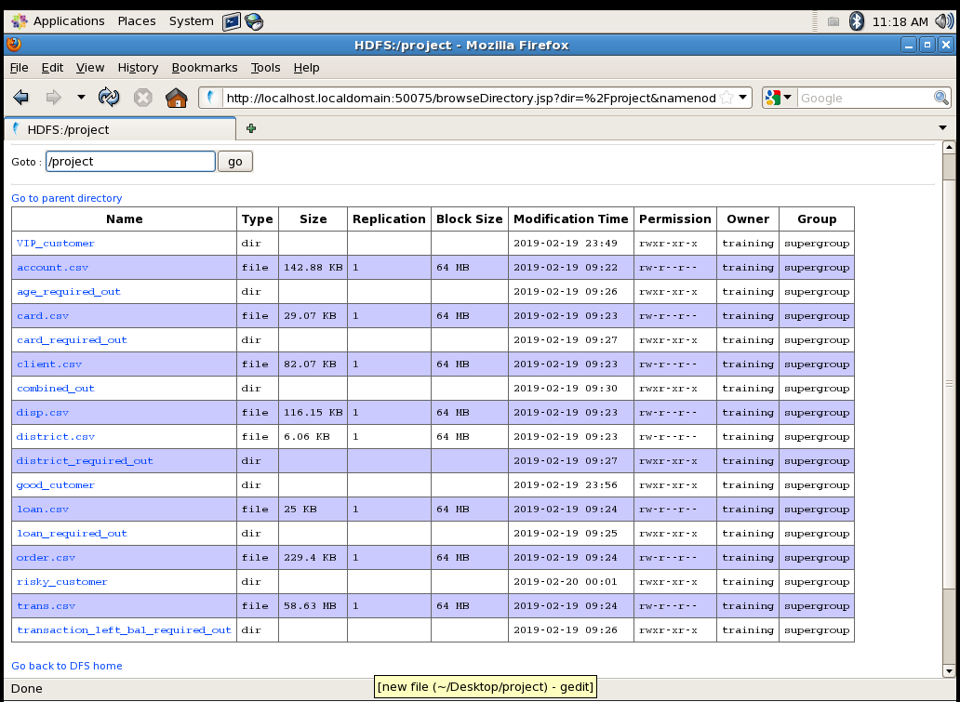

Slide 20
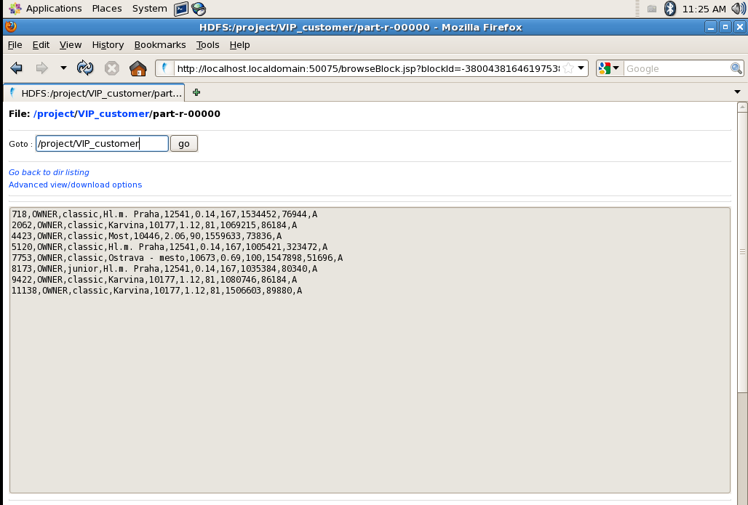

Slide 21
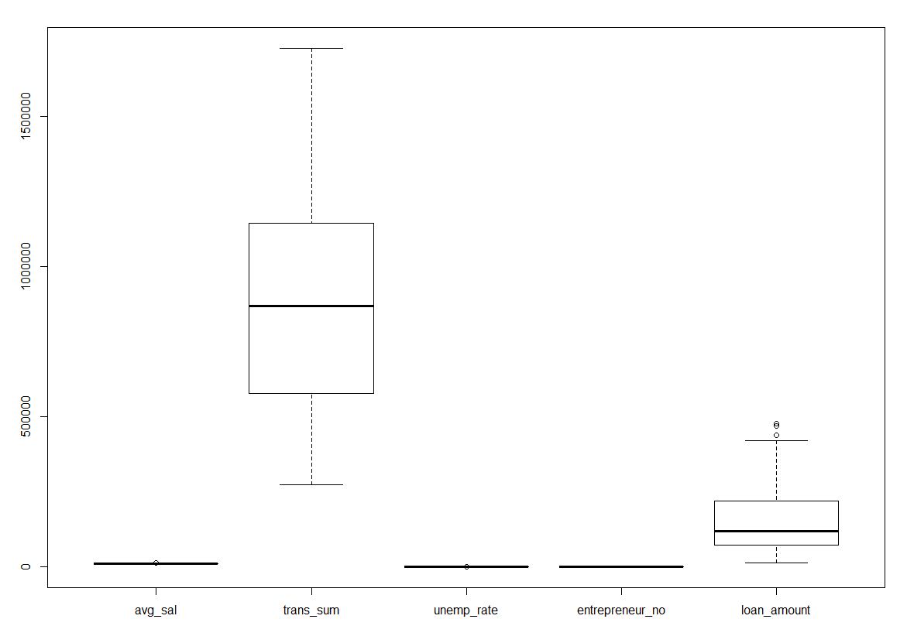
MODULE 4 CLUSTERING DATA
Box plot of Transaction used data

Slide 22
Box plot of Transactionless data

Slide 23
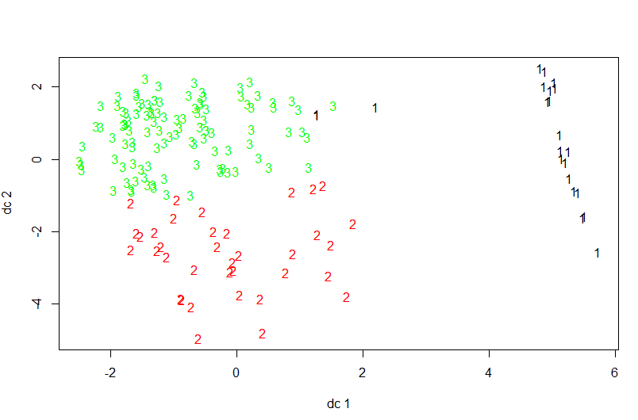
Cluster points of three clusters(transaction)

Slide 24
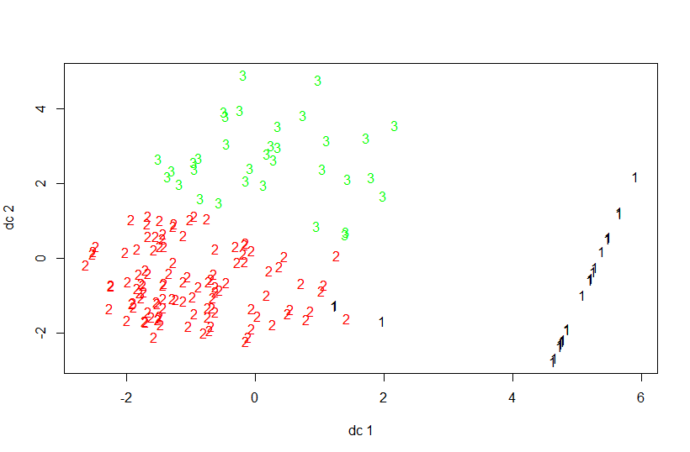
Cluster points of three clusters(transactionless)

Slide 25
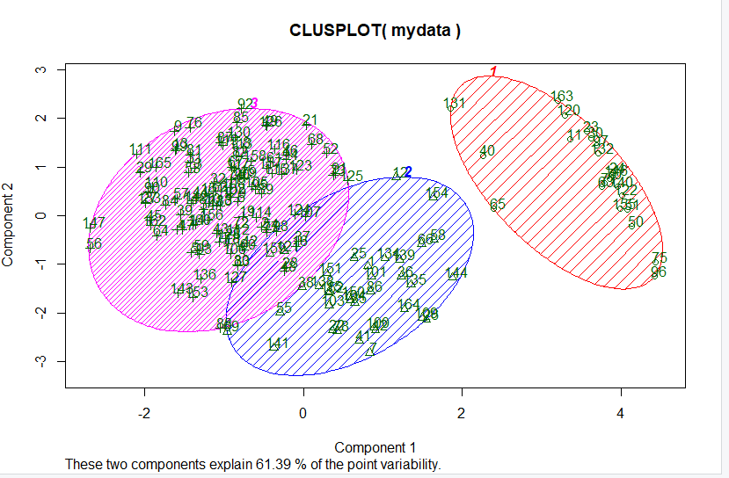
Cluster part of transaction based classification

Slide 26
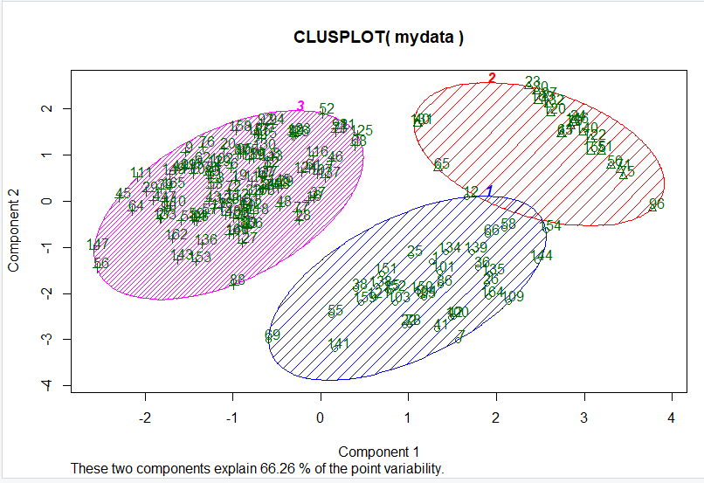
Cluster part of transactionless based classification

Slide 27
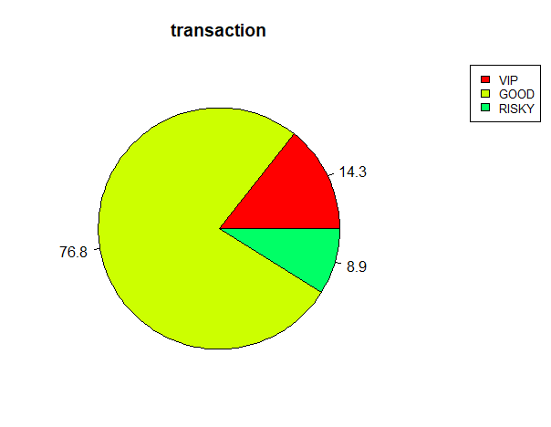
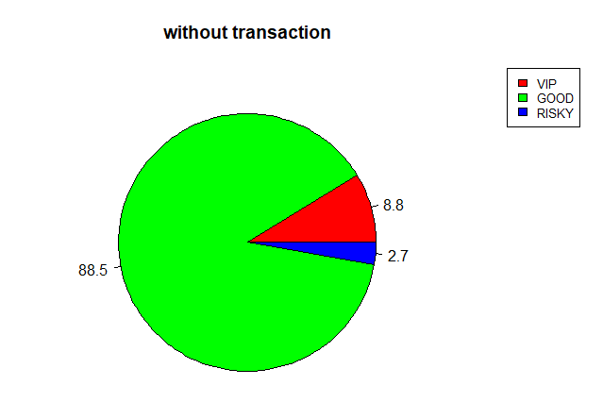
Comparison

Slide 28
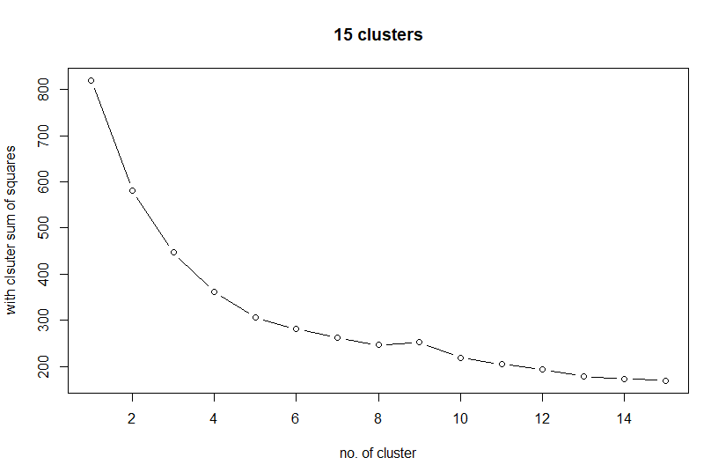
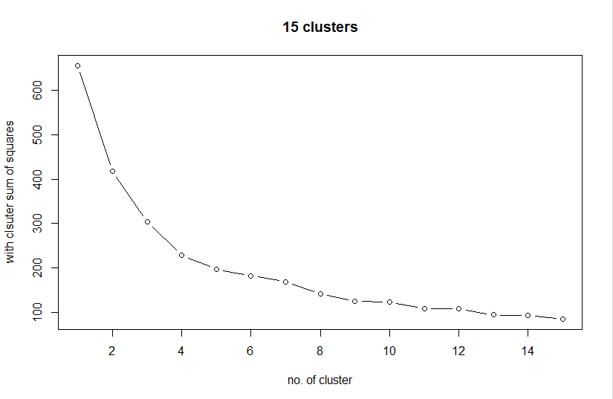
Comparing transaction used and transactionless data

Slide 29
Conclusion
Thus the system provides an easy approach for the banks to understand their customers and do business based on that.
Enables banks to target their customers and design plans based on their customers.
Result of the analysis based on transaction data is more accurate than analysis based on transaction less data

Slide 30
Future Work
Applying machine learning algorithms to the applied statistics to predict the behavior of customers.
It can be used to predict the effectiveness of a strategy or a policy of bank.
Several parameters can be improvised to provide more specialized calculations and analysis with respect to the bank.
Multinode Hadoop cluster can be set up to facilitate horizontal scaling methods used in big data

Slide 31
References
[1] Ivanilton Polato a,b,n , Reginaldo Ré b , Alfredo Goldman a , Fabio Kon: A comprehensive view of Hadoop research—A systematic literature review, Journal of Network and Computer Applications 46(2014)
[2] PrathyushaRani Merla, Yiheng Liang: Data Anlaysis Using Hadoop Map Reduce Environment, IEEE International Conference on Big Data (BIGDATA), 2017.
[3] SFeng Li, Beng Chin Ooi, M. Tamer Ozsu, and Sai Wu: Distributed data management using MapReduce, ACM Comput. Surv. 46, 3, Article 31 (January 2014)
[4] Arushi Jaina, Vishal Bhatnagara Ambedkar: Crime Data Analysis Using Pig with Hadoop, International Conference on Information Security & Privacy, 2015

Slide 32
[5] https://www.researchgate.net/publication/329402555
[6] https://www.tutorialspoint.com/apache_pig/apache_pig_user_defined_functions.html
[7] https://www.tutorialspoint.com/apache_pig
[8] https://www.edureka.co/big-data-and-hadoop
[9] https://www.statmethods.net/r-tutorial/index.html
[10]https://www.dezyre.com/article/difference-between-pig-and-hive-the-two-key-components-of-hadoop-ecosystem/79
[11]https://www.hadoop360.datasciencecentral.com/blog/pig-vs-hive-vs-sql-difference-between-the-big-data-tools

Slide 33
THANK YOU!

